Slide 1
MODULE 1

Slide 2
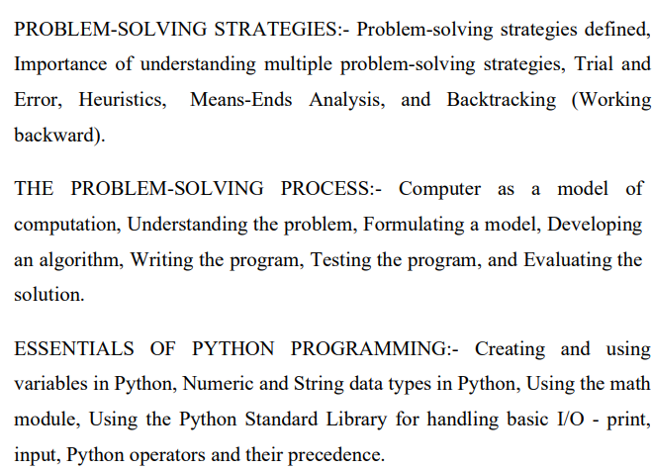
Module 1 – Syllabus

Slide 3
Contents
Problem Solving Strategies
Problem-solving strategies defined
Importance of understanding multiple problem-solving strategies
Trial and Error
Heuristics
Means-Ends Analysis
Backtracking.

Slide 4
Problem Solving Process
Computer as a model of computation
Understanding the problem
Formulating a model
Developing an algorithm
Writing the program
Testing the program
Evaluating the solution.

Slide 5
Essentials of PYTHON Programming
Creating and using variables in Python
Numeric and String data types in Python
Using the math module
Using the Python Standard Library for handling basic I/O – print, input
Python operators and their precedence.

Slide 6
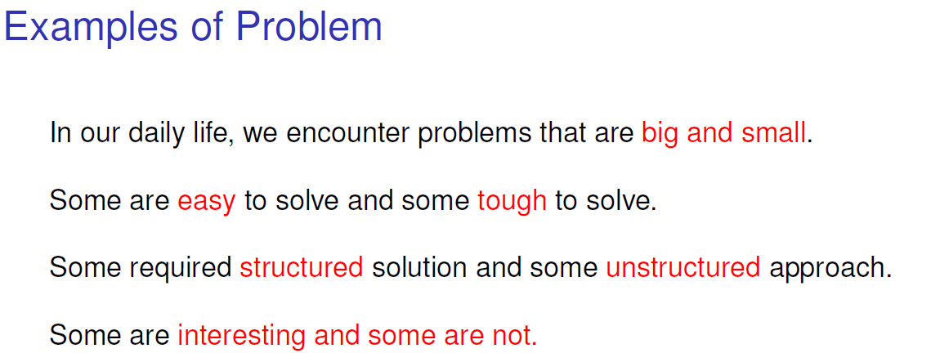
What is a Problem

Slide 7
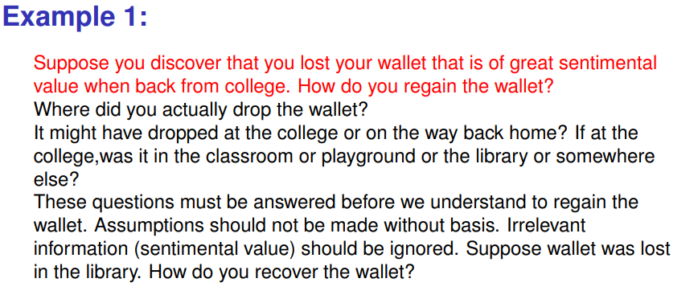

Slide 8
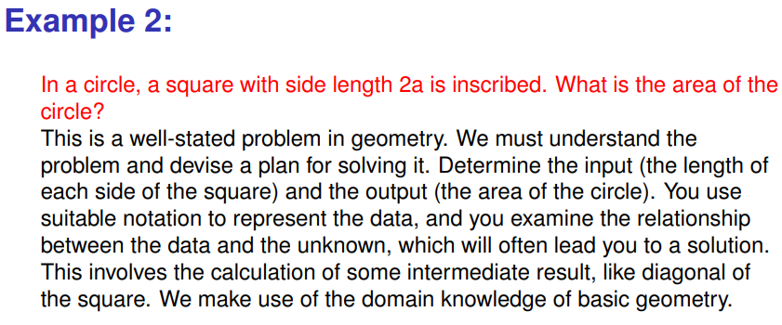

Slide 9
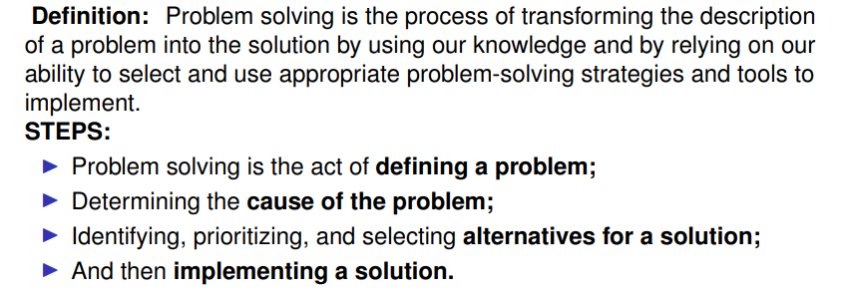
Problem Solving

Slide 10
Problem Solving in Everyday Life
People make decisions every day to solve problems that affect their lives.
The problems may be as unimportant as what to watch on television or as important as choosing a new profession.
If a bad decision is made, time and resources are wasted, so it’s important that people know how to make decisions well.
There are six steps to follow to ensure the best decision.
These six steps in problem solving include the following:
Identify the problem:
when you are doing problem solving, you need to make sure you identify the problem before you start solving it. If you don’t know what the problem is, you cannot solve it.

Slide 11
Understand the problem:
You must understand what is involved in the problem before you can continue toward the solution. This includes understanding the knowledge base of the person or machine for whom you are solving the problem. If you are setting up a solution for a person, then you must know what that person knows.
Identify alternative ways to solve the problem:
This list should be as complete as possible. You might want to talk to other people to find other solutions than those you have identified. Alternative solutions must be acceptable ones.
Select the best way to solve the problem from the list of alternative solutions:
In this step, you need to identify and evaluate the pros and cons of each possible solution before selecting the best one. In order to do this, you need to select criteria for the evaluation. These criteria will serve as the guidelines for evaluating each solution.
List instructions that enable you to solve the problem using the selected solution:
No instruction can be used unless the individual or the machine can understand it. This can be very limiting, especially when working with computers.

Slide 12
Evaluate the solution:
To evaluate or test a solution means to check its result to see if it is correct, and to see if it satisfies the needs of the person(s) with the problem.
TYPES OF PROBLEMS
Problems do not always have straightforward solutions.
Some problems, such as balancing a checkbook or baking a cake, can be solved with a series of actions. These solutions are called algorithmic solutions.
Once the alternatives have been eliminated, for example, and once one has chosen the best among several methods of balancing the checkbook, the solution can be reached by completing the actions in steps. These steps are called the algorithm.
The solutions of other problems, such as how to buy the best stock or whether to expand the company, are not so straightforward. These solutions require reasoning built on knowledge and experience, and a process of trial and error. Solutions that cannot be reached through a direct set of steps are called heuristic solutions.

Slide 13
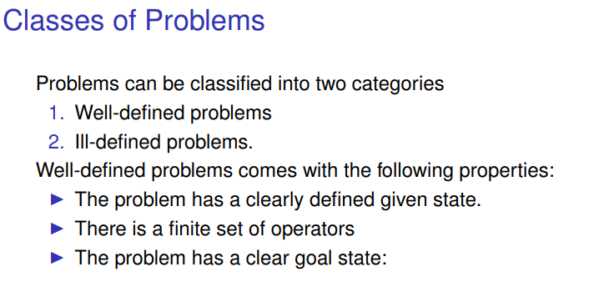

Slide 14
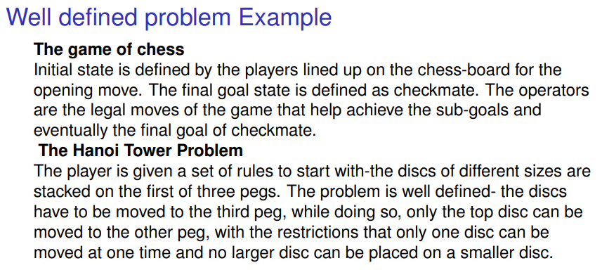

Slide 15
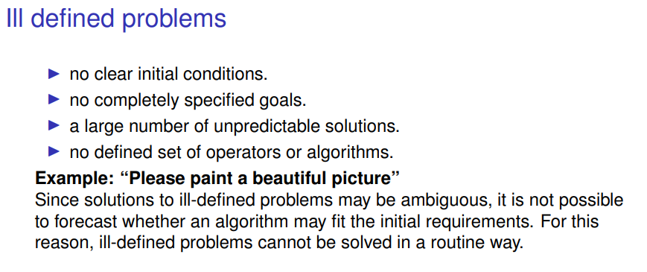

Slide 16
Problem Solving Strategies
Problem-solving strategies are essential tools that enable you to effectively tackle a wide range of challenges by providing structured methods to analyze, understand, and resolve problems.
These strategies include systematic approaches such as
Trial and Error
Heuristics
Means-Ends Analysis
Backtracking
Multiple problem solving strategies allows for adaptability and flexibility, ensuring that one can choose the most efficient method for any given situation.
This enhances problem-solving efficiency and improves outcomes by offering diverse perspectives and potential solutions.
Additionally, employing various strategies enriches cognitive skill development, critical thinking, and creativity.
Notes:
By integrating these strategies into everyday problem-solving, you can approach challenges with confidence and resilience, ultimately achieving more successful and innovative solutions

Slide 17
Importance of Understanding Multiple Problem-Solving Strategies
It equips individuals with a diverse tool kit to tackle a variety of challenges.
Different problems often require different approaches, and being familiar with multiple strategies allows for greater flexibility and adaptability.
For example, some problems might be best solved through a systematic trial and error method, while others might benefit from a more analytical approach like means-ends analysis.
By knowing several strategies, one can quickly switch tactics when one method does not work, increasing the chances of finding a successful solution.

Slide 18
Collection of problem-solving strategies enhances critical thinking and creativity.
It encourages thinking outside the box and considering multiple perspectives, which can lead to more innovative and effective solutions.
This broad understanding also helps in recognizing patterns and similarities between different problems, making it easier to apply previous knowledge to new situations.
This improves not only problem-solving efficiency but also boosts confidence and competence in facing various challenges.
Some benefits are as follows
Adaptability: Different problems require different approaches. Understanding multiple strategies allows for flexibility and adaptability in problem solving.
Efficiency: Some strategies are more effective for specific types of problems. Having a repertoire of strategies can save time and resources.
Improved Outcomes: Diverse strategies offer multiple perspectives and potential solutions, increasing the likelihood of finding optimal solutions.
Skill Development: Exposure to various strategies enhances cognitive skills, critical thinking, and creativity.

Slide 19
Common Problem-Solving Strategy
Some commonly used problem-solving strategies
Trial and Error
Heuristics
Means-Ends Analysis
Backtracking

Slide 20
Trial And Error Problem-Solving Strategy
The trial-and-error problem-solving strategy involves attempting different solutions and learning from mistakes until a successful outcome is achieved.
It is a fundamental method that relies on experimentation and iteration, rather than systematic or analytical approaches.
Consider the situation where you have forgotten the password to your online account, and there is no password recovery option available.
You decide to use trial and error to regain access:
Initial Attempts: You start by trying passwords you commonly use. For instance, you might first try ”password123,” ”Qwerty2024,” or ”MyDogTommy.”
Learning from Mistakes: None of these initial attempts work. You then recall that you sometimes use a combination of personal information. You try variations incorporating your birthdate, pet’s name, or favorite sports team.

Slide 21
3. Refinement: After several failed attempts, you remember you recently started using a new format for your passwords, combining a favorite quote with special characters. You attempted various combinations, such as ”ToBeOrNotToBe!”, ”NeeNeeyaayirikkuka#,” and other combinations.
4. Success: Eventually, through persistent trial and error, you hit upon the correct password: ”NeeNeeyaayirikkuka#2024.”
In this scenario, trial and error involved systematically trying different potential passwords, learning from each failed attempt, and refining the approach based on what you remember about your password habits. This method is practical when there is no clear pathway to the solution and allows for discovering the correct answer through persistence and adaptability.

Slide 22
Algorithmic Problem-Solving Strategy
An algorithm is a step-by-step, logical procedure that guarantees a solution to a problem. It is systematic and follows a defined sequence of operations, ensuring consistency and accuracy in finding the correct solution.
When baking a cake, you follow a precise recipe, which acts as an algorithm:
Gather Ingredients: Measure out 2 cups of flour, 1 cup of sugar, 2 eggs, 1/2 cup of butter, 1 teaspoon of baking powder, and 1 cup of milk.
Preheat Oven: Set the oven to 175°C.
Mix Ingredients: In a bowl, combine the flour, baking powder, and sugar. In another bowl, beat the eggs and then mix in the butter and milk. Gradually combine the wet and dry ingredients, stirring until smooth.

Slide 23
4.Prepare Baking Pan: Grease a baking pan with butter or cooking spray.
5. Pour Batter: Pour the batter into the prepared pan.
6. Bake: Place the pan in the preheated oven and bake for 30-35 minutes.
7. Check for Doneness: Insert a toothpick into the center of the cake. If it comes out clean, the cake is done.
8. Cool and Serve: Let the cake cool before serving.
By following this algorithm (the recipe), you systematically achieve the desired result - a perfectly baked cake.

Slide 24
Heuristic Problem-Solving Strategy
A heuristic is a practical approach to problem-solving based on experience and intuition. It does not guarantee a perfect solution but provides a good enough solution quickly, often through rules of thumb or educated guesses.
When driving in a city with frequent traffic congestion, you might use a heuristic approach to find the fastest route to your destination:
1. Rule of Thumb: You know from experience that certain streets are typically less congested during rush hour.
2. Current Conditions: You use a traffic app to check current traffic conditions, looking for red or yellow indicators on major roads.
3. Alternative Routes: You consider side streets and shortcuts you have used before that tend to be less busy.
4. Decision: Based on the app and your knowledge, you decide to avoid the main highway (which shows heavy congestion) and take a series of back roads that usually have lighter traffic.
While this heuristic approach does not guarantee that you will find the absolute fastest route, it combines your experience and real-time data to make an informed, efficient decision, likely saving you time compared to blindly following the main routes.

Slide 25
Both algorithms and heuristics are ways of solving problems, but they have different advantages and disadvantages. Algorithms are more reliable and accurate, but they can also be more complex and time-consuming.
Heuristics are more flexible and efficient, but they can also be more error-prone and biased. We can combine algorithms and heuristics to create hybrid solutions that balance the trade-offs. For example, you can use a heuristic to narrow down the search space, and then apply an algorithm to find the best solution within that space.

Slide 26
Means-Ends Analysis Problem-Solving Strategy
Means-ends analysis is a strategy that involves breaking down a problem into smaller, manageable parts (means) and addressing each part to achieve the final goal (ends). It involves identifying the current state, the desired end state, and the steps needed to bridge the gap between the two.
Imagine you want to plan a road trip from Trivandrum to Kashmir. Here is
how you might use means-ends analysis.
1. Define the Goal: Drive from Trivandrum to Kashmir.
2. Analyze the Current State: You start in Trivandrum.
3. Identify the Differences: Distance between Trivandrum and Kashmir is approximately
3,700 kilometers.
4. Set Sub-Goals (Means):
Fuel and Rest Stops: Where to stop for fuel and rest.
Daily Driving Targets: Break the trip into daily segments, such as driving 500-600 km per day.
Route Planning: Choose the most efficient and scenic route, considering highways, weather conditions, and places you want to visit.

Slide 27
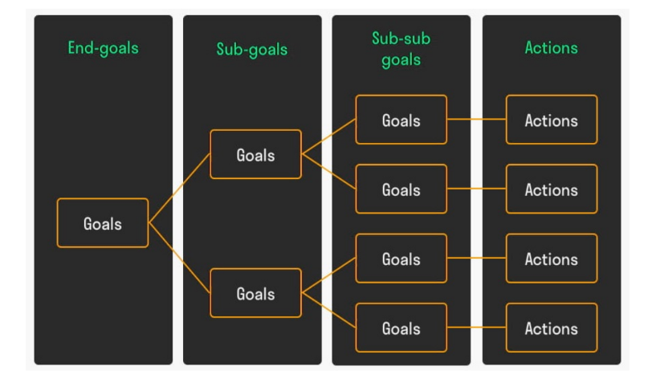
Means-Ends Analysis Problem-Solving Strategy
5. Implement the Plan:
• Day 1: Drive from Trivandrum to Bangalore, Karnataka (approx. 720 km).
Refuel in Madurai, Tamil Nadu. Overnight stay in Bangalore.
• Day 2: Drive from Bangalore to Hyderabad, Telangana (approx. 570 km).
Refuel in Anantapur, Andhra Pradesh. Overnight stay in Hyderabad.
......
• Day 8: Drive from Jammu to Srinagar, Kashmir (approx. 270 km).
6. Adjust as Needed:
Throughout the trip, you may need to make adjustments based on traffic, road conditions, or personal preferences.

Slide 28
Problem decomposition
When the problem to be solved is too complex to manage, break it into manageable parts known as sub-problems. This process is known as problem decomposition.
The steps in solving a problem using the decomposition approach is as follows:
Understand the problem: Develop a thorough understanding of the problem.
2. Identify the sub-problems: Decompose the problems into smaller parts.
3. Solving the sub-problems: Once decomposition is done, you proceed to solve the individual sub-problems. You may have to decide upon the order in which the various sub-problems are to be solved.
4. Combine the solution: Once all the sub-problems have been solved, you should combine all those solutions to form the solution for the original problem.
5. Test the combined solution: Finally you ensure that the combined solution indeed solves the problem effectively.

Slide 29
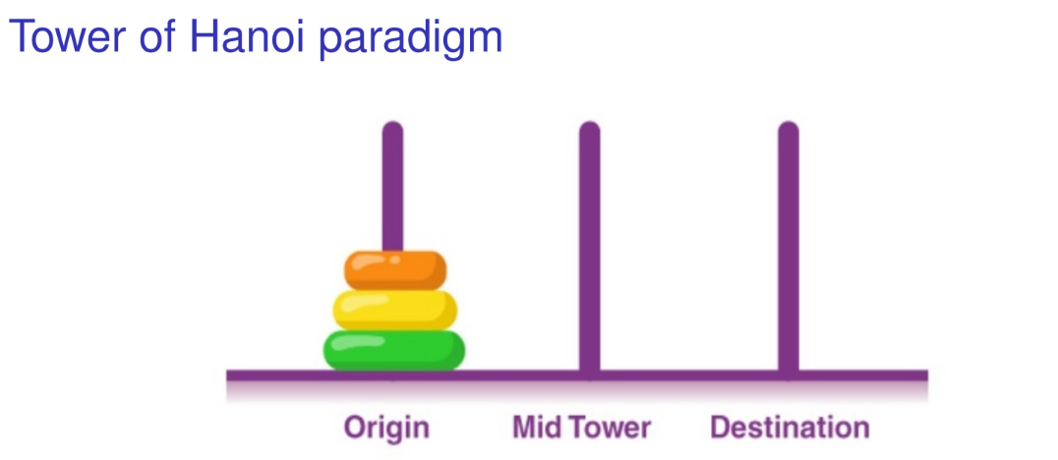

Slide 30
Tower of Hanoi
The actual Tower of Hanoi problem consists of three rods sitting vertically on a base with a number of disks of different sizes that can slide onto any rod. The puzzle starts with the disks in a neat stack in ascending order of size on one rod, the smallest at the top making a conical shape.
The objective of the puzzle is to move the entire stack to another rod obeying the following rules:
1. Only one disk can be moved at a time.
2. Each move consists of taking the upper disk from one of the stacks and
placing it on top of another stack or on an empty rod.
3. No larger disc may be placed on top of a smaller disk.

Slide 31

Tower of Hanoi
With 3 disks, the puzzle can be solved in 7 moves. The minimal moves required to solve a Tower of Hanoi puzzle is , where n is the number of disks. For example, if there were 14 disks in the tower, the minimum amount of moves that could be made to solve the puzzle would be 2 ^14 – 1 =16,383 moves.
There are various ways of approaching the Tower of Hanoi or its related problems such as an iterative solution, recursive solution, non-recursive solution, a binary and Gray-code solutions, and graphical representations.

Slide 32
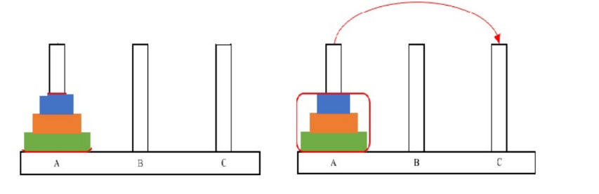

Slide 33
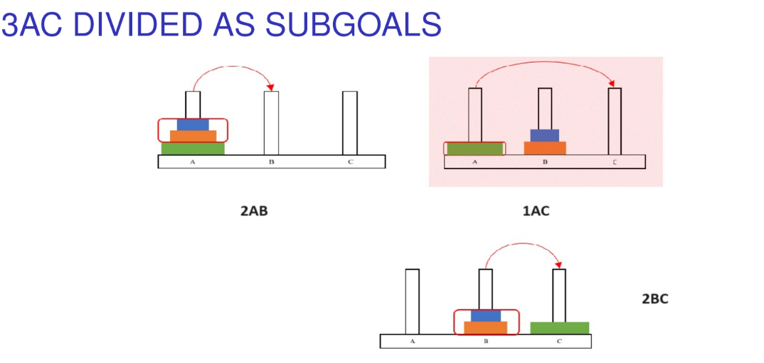

Slide 34
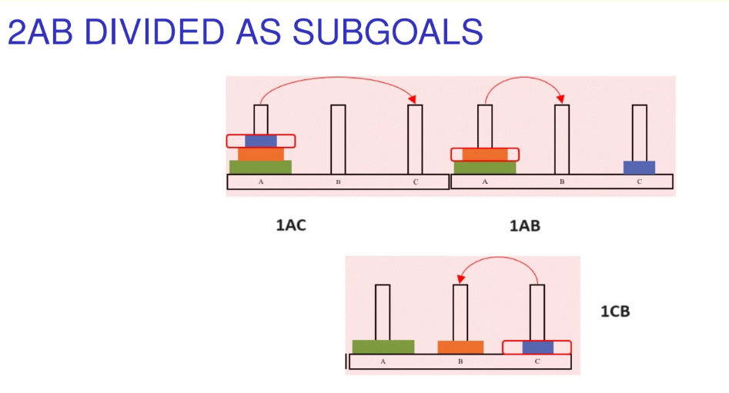

Slide 35
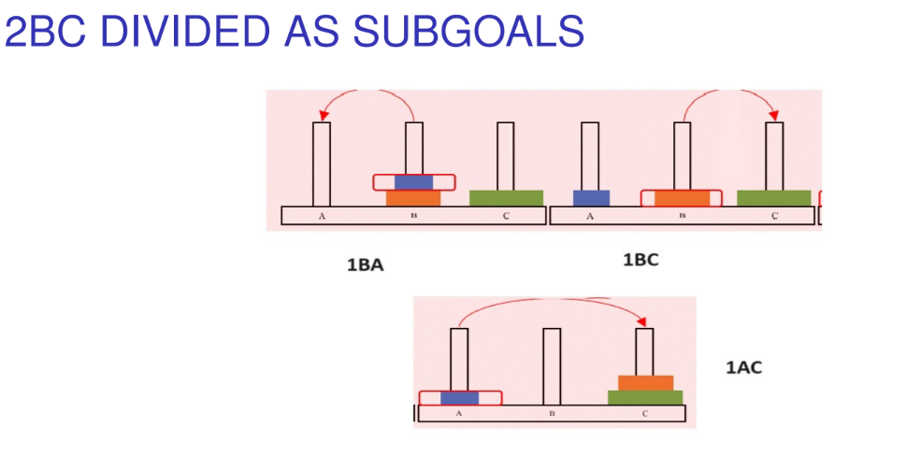

Slide 36
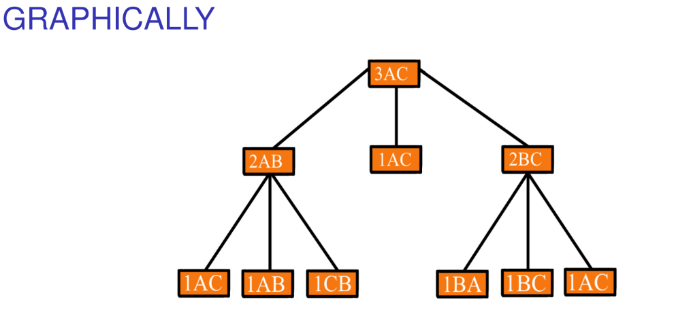

Slide 37
Other Problem-solving Strategies
Brainstorming
Brainstorming involves generating a wide range of ideas and solutions to a problem without immediately judging or analyzing them. The goal is to encourage creative thinking and explore various possibilities.
2. Lateral Thinking
Lateral thinking is about looking at problems from new and unconventional angles. It involves thinking outside the box and challenging established patterns and assumptions.
3. Root Cause Analysis
Root cause analysis involves identifying the fundamental cause of a problem rather than just addressing its symptoms. The goal is to prevent the problem from recurring by solving its underlying issues.

Slide 38
4. Mind Mapping
Mind mapping is a visual tool for organizing information. It helps in brainstorming, understanding, and solving problems by visually connecting ideas and concepts.
6. SWOT Analysis
SWOT analysis involves evaluating the Strengths, Weaknesses, Opportunities, and Threats related to a particular problem or decision. It helps in understanding both internal and external factors that impact the situation.
7. Decision Matrix
A decision matrix, also known as a decision grid or Pugh matrix, helps in evaluating and prioritizing a list of options. It involves listing options and criteria, assigning weights to each criterion, and scoring each option based on the criteria.

Slide 39
8. Simulation
Simulation involves creating a model of a real-world system and experimenting with it to understand how the system behaves under different conditions. It helps in predicting outcomes and identifying the best course of action.
9. Use Experience
The use of experience as a problem-solving strategy involves drawing on previous knowledge and experiences to address current challenges. This strategy relies on the idea that similar problems often have similar solutions, and leveraging past experiences can lead to efficient and effective outcomes.

Slide 40
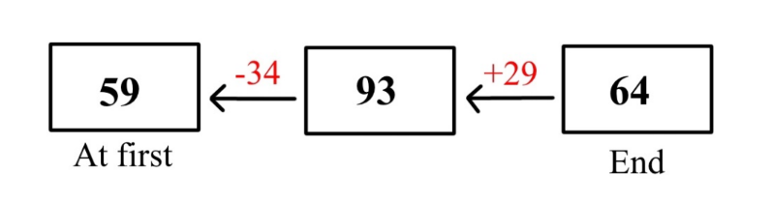
Backtracking
Working Backwards is a problem-solving strategy in which you start with the end goal and work backward to figure out the steps needed to get there. In other words, instead of starting from the beginning and moving forward, you start from the end and move backward. This strategy is commonly used in math problems that ask you to find a starting value or figure out what happened before a given situation.
Example 1: Sarah had some pens. She bought 34 pens. She then threw away 29 pens as they were spoilt. In the end, she had 64 pens. How many pens did Sarah have at first?

Slide 41
Always remember when we work backwards, everything will be reversed, eg: instead of adding, we subtract.
We will start drawing the model from the end by drawing a box and label it “End”. Put the end amount “64” in the box.
Draw arrow to point to the left, draw another box. On top of the arrow write “+29” as “Sarah threw away 29 pens”. Instead of subtract, we need to add. In the box, write “93” (64+29=93).
Draw another arrow to point to the left, draw another box. On top of the arrow, write “-34” as Sarah bought 34 pens. Instead of adding, we need to subtract. In the box, write “59” (93-34=59). Label the box “At First” or “Before”.
Sarah had 59 pens at first.

Slide 42
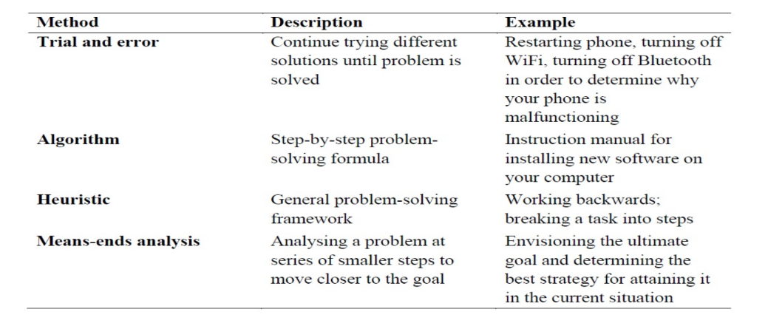
Summary of Problem Solving Strategies

Slide 43
Problem solving process
Understand the problem: Effective problem-solving demands a thorough knowledge of the problem domain. Once you have identified the problem, its exact nature must be sought and defined. The problem context, objectives, and constraints if any are to be understood properly.
Several techniques can be used to gather information about a problem. Some of these include conducting interviews and sending questionnaires to the stakeholders (people who are concerned with the problem). Segmenting a big problem into simple manageable ones often helps you to develop a clear picture of the problem.

Slide 44
Formulate a model for the solution: After the problem is thoroughly understood, the next step is to devise a solution.
You should now identify the various ways to solve the problem. Brainstorming is one of the most commonly used techniques for generating a large number of ideas within a short time.
Brainwriting and Mind mapping are two alternative techniques employed here.
The generated ideas are then transformed into a conceptual model that can be easily converted to a solution. Mathematical modeling and simulation modeling are two popular modeling techniques used.
Develop an algorithm: Once a list of possible solutions is determined, they have to be translated into formal representations – algorithms. We do not implement all the solutions. So the next step is to assess the pros and cons of each algorithm to select the best one for the problem. The assessment is based on considering various factors such as memory, time, and lines of code.

Slide 45
Code the algorithm: After the best algorithm is determined, you implement it as an executable program. The program or the code is a set of instructions that is more or less, a concrete representation of the algorithm in some programming language. While coding, always follow the incremental paradigm – start with the essential functionalities and gradually add more and more to it.
Test the program: Once you are done with the coding, you have to inspect your code to verify its correctness. This is formally called testing.
During testing, the program is evaluated as to whether it produces the desired output. Any unexpected output is an error. The program should be executed with different sets of inputs to detect errors.

Slide 46
It is impossible to test the program with all possible inputs.
Instead, a smaller set of representative inputs called test suite is identified and if the program runs correctly on the test suite, then it is concluded that the program will probably be correct for all inputs. There are automated testing tools to generate a test suite for your code.
Closely associated with testing is the process of debugging which involves fixing or resolving the errors (technically called bugs) identified during testing. Testing and debugging should be repeated until all errors are fixed.
Evaluate the solution: This final step is to ensure that the program effectively addresses the problem and attains the desired objectives. You have to first define the evaluation criteria. These could include metrics like efficiency, feasibility, and scalability etc. The potential risks that could arise with the program’s deployment are also to be assessed. Collect quantitative and qualitative feedback from the stakeholders. Based on the feedback, you have to work on making necessary improvements to the program. The refined code should also be subject to rigorous testing.

Slide 47

Case study - The Discriminant calculator
Understand the problem: Here we formally define the problem by specifying the inputs and output.
Input: The three coefficients a, b and c of the quadratic equation
Output: The discriminant value D for the quadratic equation
Formulate a model for the solution: Develop a mathematical model for the solution, that is identify the mathematical expression for the quadratic equation discriminant
Develop an algorithm: A possible algorithm (actually, a pseudocode) for discriminant problem is given below:

Slide 48
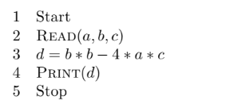
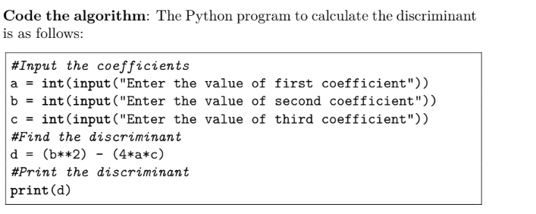

Slide 49
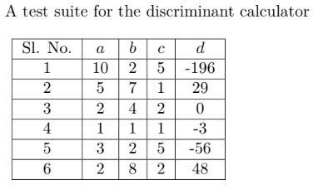
Test the program: Create a test suite .
Each row denotes a set of inputs (a, b, and c) and the expected output (d) with which the actual output is to be compared.

